Slide 1


UNIVERSITY OF LAYYAH
INFORMATION TECHNOLOGY
Project
Snake Game Development
Submitted To
Submitted By
MR. FAISAL HAFEEZ
Naseem Hayyat 23-49
Mudassar Raza 23-02
Abdur Rehman 23-70
M Usman 23-24
Head of Department of
Information Technology

Slide 2
Title:
Snake Game Development Using HTML5 Canvas and JavaScript.
Project Overview:
The objective of this project is to design and develop a classic Snake game using HTML5 Canvas and JavaScript.
The game will feature a snake that moves around the screen, eats apples, and grows in length.
The game will also include collision detection, scoring, and keyboard controls.

Slide 3
Project Features:
Game Loop
Snake Movement
Apple Generation
Scoring System
Collision Detection
Game Reset
Responsive Design

Slide 4
Data Structure:
Array
Linked Lists
Hash Tables

Slide 5
Tools and Resources:
Visual Studio Code or similar IDE.
Google Chrome or Firefox browser.
HTML5 Canvas and JavaScript documentation.
Stack Overflow and online forums.

Slide 6
Working:
Game Initialization
Game Loop
Event Handling
Game Logic
Rendering
Game Over

Slide 7
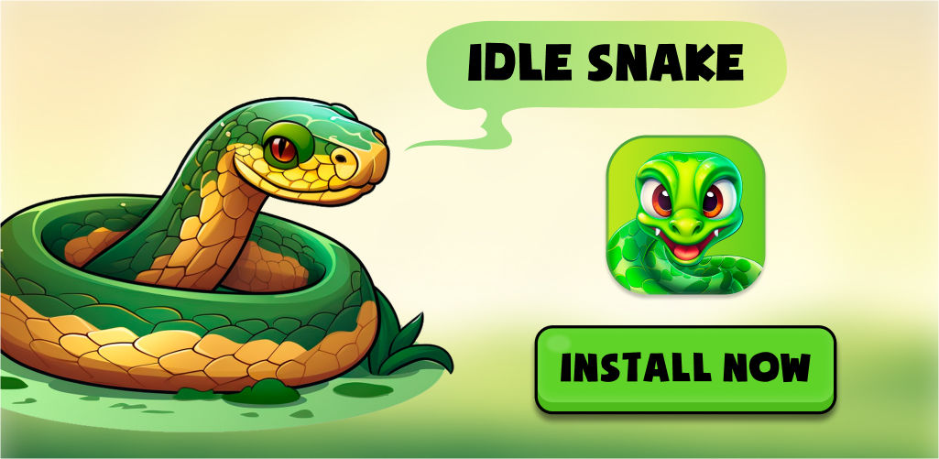
Background:

Slide 8
Conclusion:
The Snake game project aims to demonstrate proficiency in HTML5 Canvas and JavaScript game development. By completing this project, I will gain hands-on experience in game design, implementation, and optimization.

